Slide 1

Evaluation of Style Advisor Performance
A Comprehensive Data-Driven Diagnostic Report & Strategic Road Map for Excellence in Premium Retail Service Delivery

Slide 2
Strategic Context & Objectives
Aligning retail operational standards with customer-centric excellence.

Slide 3


Executive Project Overview & Scope
Project Mission
Analytical Scope
•
Evaluate multi-stage performance of Style Advisors across store audits.
•
Performance Grading: Multi-tier classification of advisors.
•
Analyze operational metrics from store ambiance to closure.
•
Zonal Breakdown: Regional score benchmarks and comparisons.
•
Pinpoint geographical excellence and operational performance gaps.
•
Behavioral Audit: Assessing Discovery, Trial, and Upselling gaps.
•
Deliver actionable, data-backed management recommendations.
•
Time Analytics: Tracking monthly performance fluctuations.

Slide 4

Performance Grading Methodology
Performance Tier | Score Parameter | Operational Implication | Excel Logic Formulation
High Performer | 90% - 100% | Exceeds all service expectations; primary brand ambassador. | =IFS(C2>=90, "High Performer", ...)
Average Performer | 70% - 89% | Meets baseline criteria; requires targeted enhancement. | =IFS(..., C2>=70, "Average Performer", ...)
Low Performer | 50% - 69% | Struggles with advanced sales and conversion tactics. | =IFS(..., C2>=50, "Low Performer", ...)
Bottom Performer | Below 50% | Critical risk; requires immediate intervention or PIP. | =IFS(..., C2<50, "Bottom Performer")

Slide 5
Regional Analysis & Insights
Uncovering geographical hubs of excellence and critical areas of concern.

Slide 6
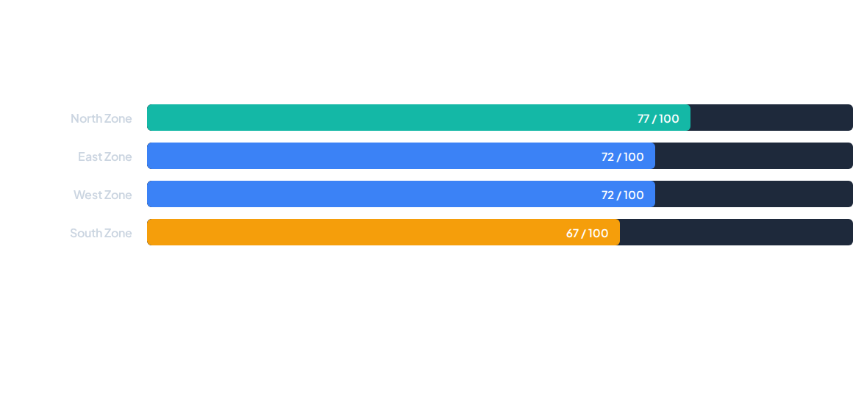
Average Evaluation Scores by Zone
The North Zone sets the organizational benchmark at 77, while the South Zone lags behind at 67, highlighting significant regional variance in service execution.

Slide 7


Concentration of Top Talent (High Performers)
Key Geographical Highlights
60%
•
North Zone Leadership: Houses 40% of all high performers, driven predominantly by Uttar Pradesh (20%).
•
Regional Anchors: Maharashtra (West) and Tamil Nadu (South) each contribute 20% to the high-performer pool.
Concentrated in Top 3 States (UP, Maharashtra, Tamil Nadu)
•
Orissa Excellence: Achieves the highest single-state quality score in the country at 94.

Slide 8






Core Competency Gap: High vs. Bottom Performers
Store Ambiance
Discovery & Needs
Trial & Upselling
High: 97% Low: 88% Basic maintenance and operational checklists are universally well-maintained across tiers.
High: 98% Low: 53% The single largest drop-off point. Advisors struggle with proactive, open-ended customer profiling.
High: 96% Low: 49% Crucial conversion gap. Low performers fail to cross-sell and promote brand programs effectively.

Slide 9
Strategic Recommendations
Actionable initiatives to bridge gaps and scale enterprise-wide excellence.

Slide 10


Roadmap for Operational Transformation
1. Targeted Sales Enablement
2. Centers of Excellence & Mentorship
•
Implement scenario-based role-play modules focused entirely on Discovery and Objection Handling.
•
Establish peer-shadowing programs pairing struggling branches (e.g., Assam, MP) with top hubs in UP and Orissa.
•
Move teams beyond transactional greetings into solution-oriented styling conversations.
•
Deploy 2-week virtual mentorship sprints to humanize high-score behaviors.

Slide 11
Immediate Management Interventions
Audit Zero-Score Outliers
Just-in-Time Micro-Learning
•
Conduct immediate root-cause audits for advisors maintaining pristine store ambiance scores but logging a 0 overall experience.
•
Combat monthly performance volatility (notably mid-month troughs around October 20th) via in-store tablet refreshers.
•
Address critical behavioral deal-breakers or attendance gaps through structured PIPs.
•
Sustain engagement through proactive support before fatigue sets in.

Slide 12
Questions & Discussion
Thank you for your attention. Let's elevate customer experience together.
Project: Style Advisor Performance Audit | CX-138-MOR-JUNE

